Slide 1
Partnering with Publishers
Access to Special Collections
J. Trzeciak
November 2012

Slide 2
Education Advisory Board
“provides best practice research and practical advice to academic, business, and student affairs leaders”
“teams of consultants and analysts dedicated to uncovering the best ideas from across higher education”

Slide 3
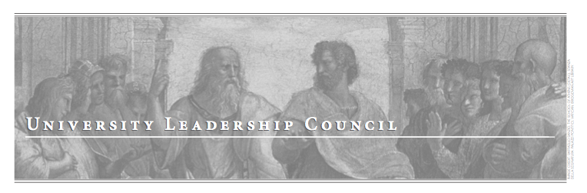
“support provosts and the institutional leadership team on issues central to the academic and research mission”
“Areas of expertise include improving student access, retention and outcomes as well as strategies for maintaining research and teaching excellence in the current funding environment”

Slide 4
“Redefining the Academic Library: Managing the Migration to Digital Information Services”

Slide 5
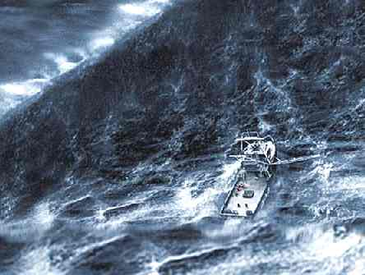
Perfect Storm
Technological shifts
Changing user expectations
Budgetary Constraints
“Adapt or risk obsolescence”

Slide 6
^{Top Lessons Learned:}
Publisher Partnerships Bring New Life to Special Collections
In an era when large collections of monographs and journals no longer signify distinction among academic libraries, special collections have become an oft-cited source of prestige.
^{However, libraries struggle} to derive maximal value from these archives and may not be able to afford to digitize, promote, and disseminate their contents.
Partnerships with publishers and other organizations can transfer much of that responsibility to those with the appropriate resources, while granting libraries the chance to build their “brand” and expand the reach of their collections through digitization and distribution.

Slide 7
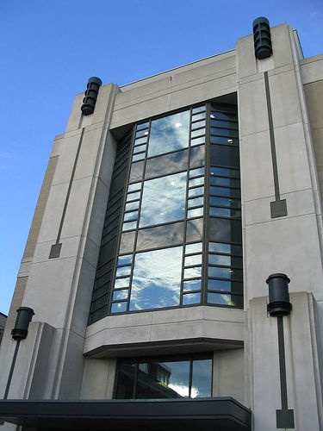
Archives and Special Collections
William Ready Division of Archives and Research Collections
35,000 pre-1800 books and journals
Literature and music
Canadian social history and politics,
Canadian publishing,
Philosophy
Labour
Popular culture,
Peace and war

Slide 8

Archives and Special Collections
Home to the academic study of Bertrand Russell (philosopher, mathematician, activist)
Russell Archives
Russell Research Centre

Slide 9



Archives and Special Collections
Recent additions
Holocaust and Resistance
Miss Lou (Jamaican singer, song-writer, activist)
Pirate Group (Canadian Advertising)

Slide 10
The Challenges
Growing collections
Growing complexity of collections
Pirate Group: mostly digital media.
Robert J Sawyer: potential for e-files as well as print

Slide 11
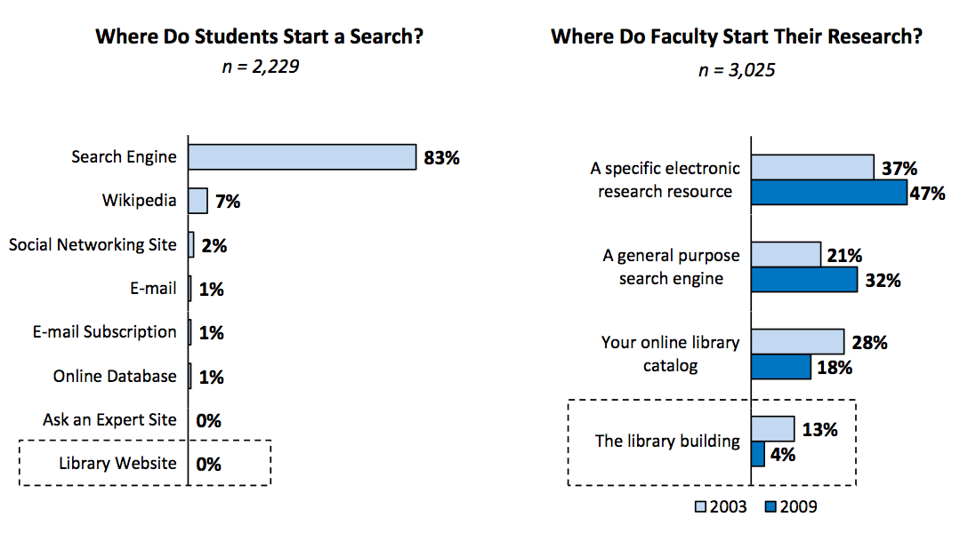
The Challenges
Increased patron demands
Changing user behaviors – how do we reach them?

Slide 12
The Opportunity
Report from internal review of special collections
Report from The Advisory Board Company (“Provosts Report on Academic Libraries”)
Both indicate: Special collections moving from the periphery to the centre of our service offerings
Need to move from “just in case” to “just in time”

Slide 13
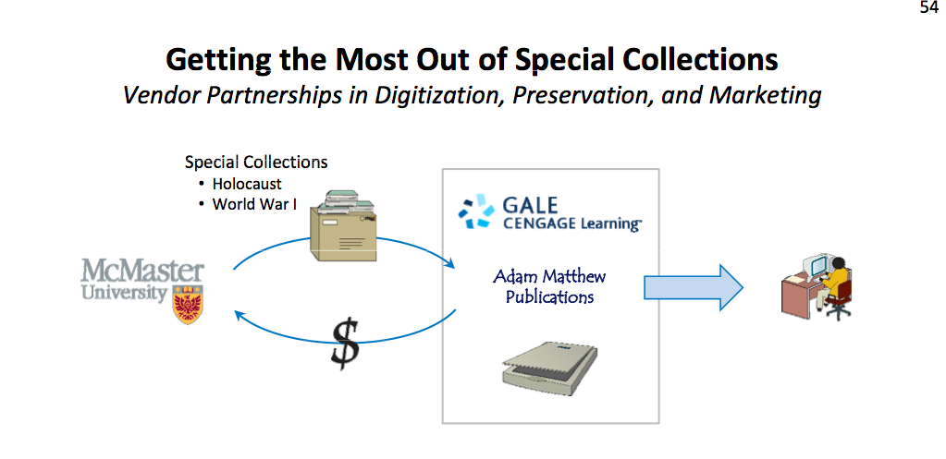
The Opportunity
The Advisory Board

Slide 14
The Opportunity
Work with Gale and Adam Matthew to:
Build digital content
Develop metadata
Expose our collections
Preserve digitized materials
Gain access to new materials
Earn some revenue

Slide 15
The Opportunity
Gale
Emphasis on Holocaust and Resistance
  Letters sent to concentration camps
  Correspondence from prisoners
  Jewish underground resistance
Focused only on McMaster materials
Allow free and open access to local Hamilton/Burlington schools

Slide 16
The Opportunity
Adam Matthew
Emphasis on World War I, Individual Experiences, Trench Literature and Images of War
International collaboration:
Cambridge University Library
Bibliothek für Zeitgeschichte in the Württembergische Landesbibliothek, Stuttgart
National WWI Museum at Liberty Memorial, Kansas City
Mills Memorial Library, McMaster University, Canada
Alexander Turnbull Library, National Library of New Zealand
Brotherton Library, University of Leeds

Slide 17
The process
All digitization performed on-site
Publisher
pays for digitization of all materials
pays for development of all metadata
develops access systems
provides free access in perpetuity to McMaster
deposits materials in Portico
markets materials
handles any copyright issue
reports back to library periodically
Pays 15% royalties

Slide 18
The process
The library:
Selects materials
Evaluates for issues related to conservation
Provides space for digitization
15% royalty paid to us on net revenues
Can provide 20% open access

Slide 19
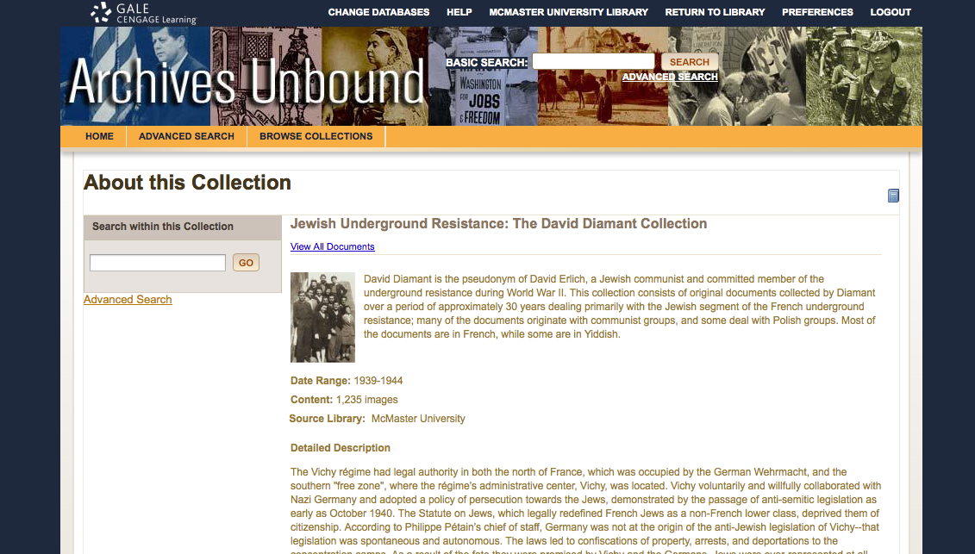
Examples

Slide 20
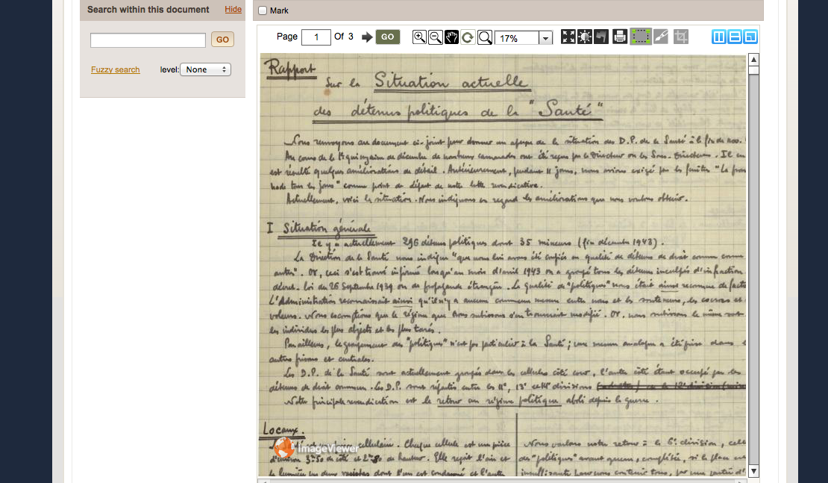
Examples

Slide 21
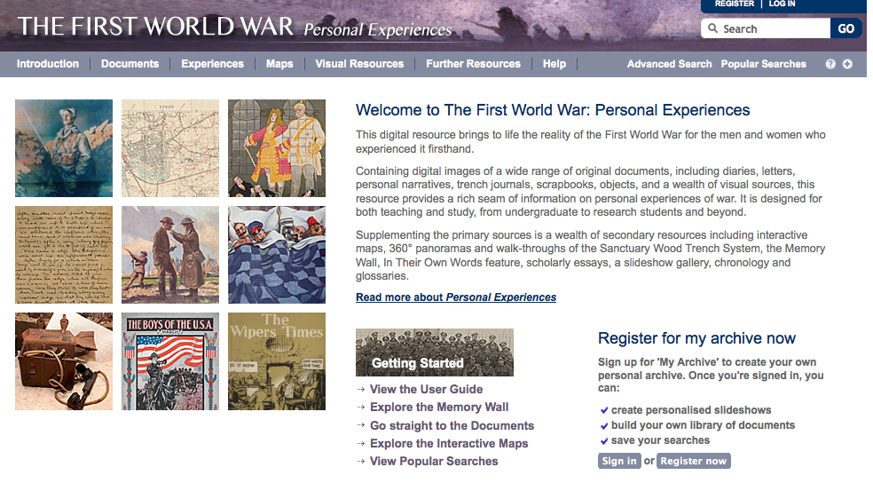
Examples

Slide 22
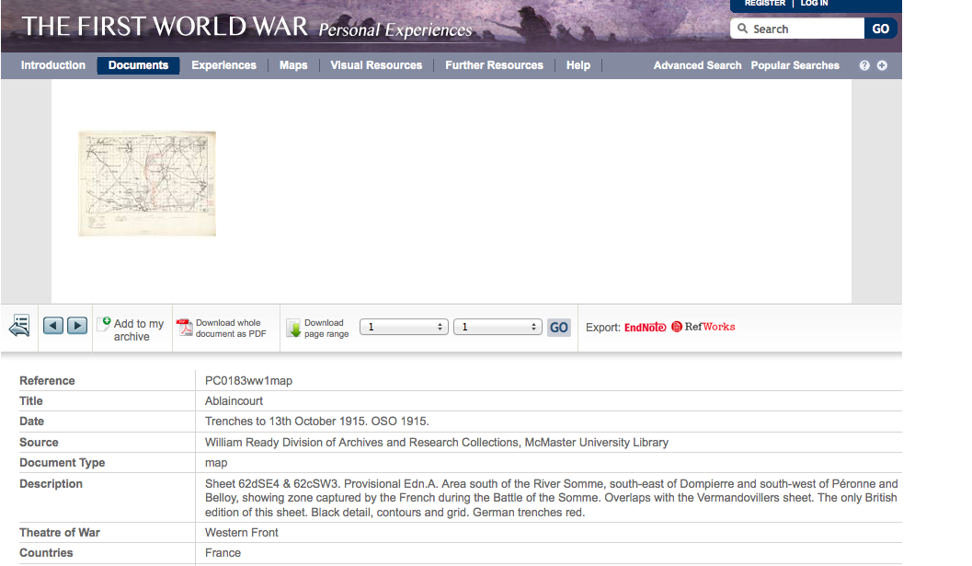
Examples

Slide 23
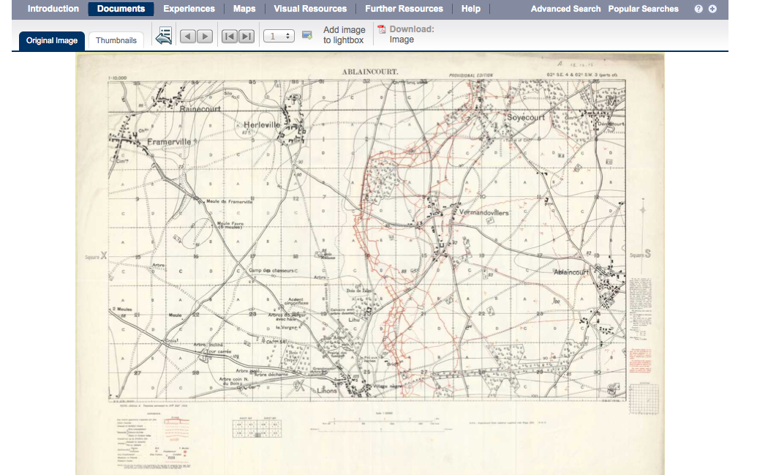
Examples

Slide 24
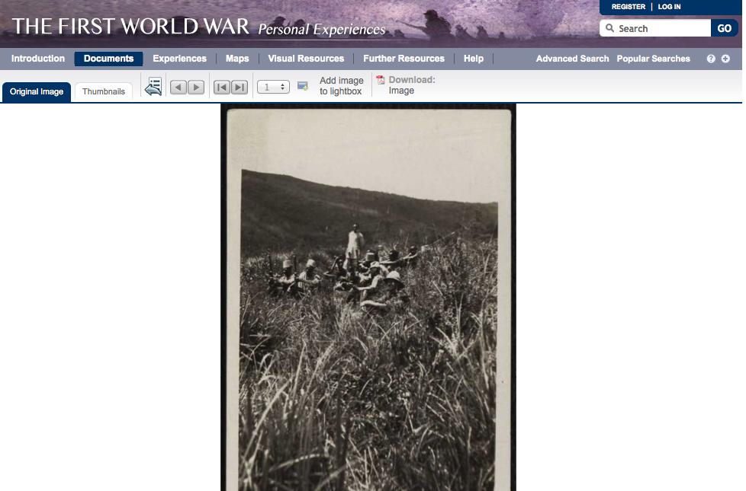
Examples

Slide 25
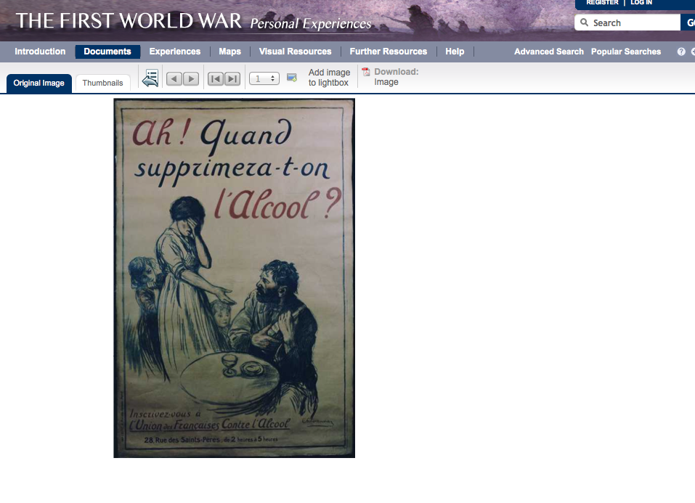
Examples

Slide 26
Next Steps
New signed agreement with Gale on Canadian pamphlets and communist papers.
Working on new agreement with Adam Matthew on 18th Century journal collection.

Slide 27
Next Steps @ WUSTL
Working with Adam Matthew on 20th Century Civil Rights Collections
Possible collaboration with the Mercantile Library in STL
Possible collaboration with Backstage for digitization

